Slide 1
Crisis? What (housing)crisis?
Calderdale CLT 4 June 2018
Dr Alison Wallace, Centre for Housing Policy, SPSW
alison.wallace@york.ac.uk
Notes:
Thank you for the invitation
Speak about eh housing crisis as introduction to this series of talks to support the community led housing in Hebden Bridge.
Look at the crisis, who is it for?
Quick few headlines about housing at the moment and then we’ll look at the issues in a bit more depth
And end with discussion bout what might fuel the current housing crisis and therefoe what might be done to resolve the problems.

Slide 2
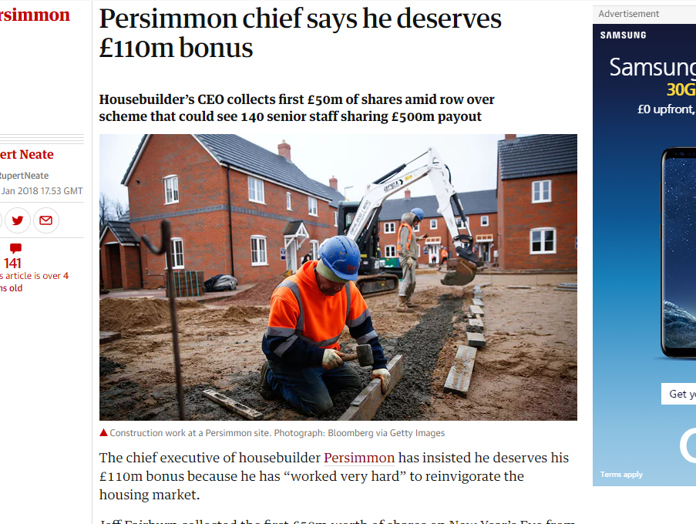
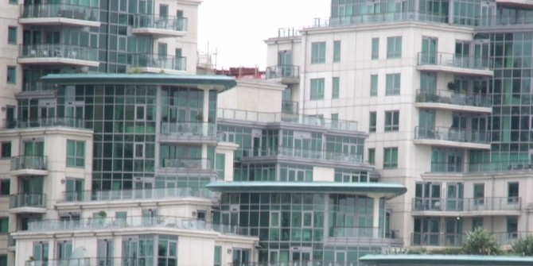
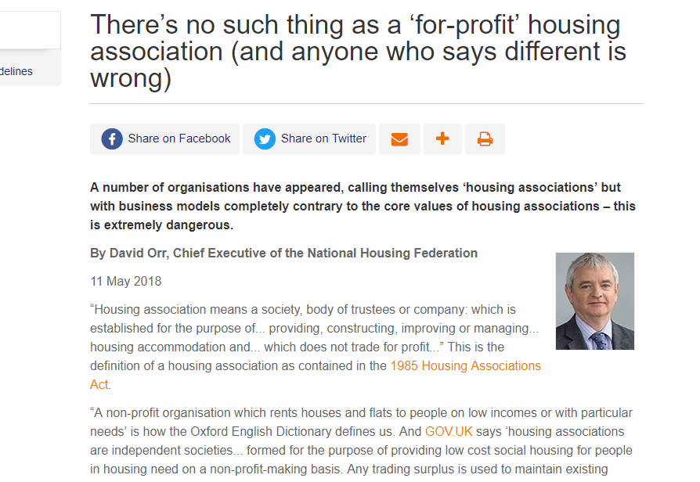
Notes:
Are we in a housing crisis? Is this just business as normal? Is this how key actors have shaped the market or housing system to be?
If it is a crisis, who for? Not for everybody, some people are doing very well out of the housing market.
Persimmon – developer shares up – bonus on back help to buy (grant subsidies to developers to increase outputs paid for by new buyers)
Wilson bogie man of BTL but amassed huge portfolio and huge rewards and disinclined to take HB tenants and minority ethnic tenants
Overseas and other wealthy individuals and companies using London and Manchester and other cities housing markets as safety deposit boxes, safe storage of wealth – not always legally gained/much money laundering - and leveraged investment which up till recently reaped high capital gains even if homes left completely empty (6% overseas investors)
And now we see the entry into the social housing sector of ‘for profit’ landlords, not to reinvest surpluses but to pay share holders or investors.
Social housing seen as underinvested.
Some of these may be seen at the limit of regular experience sof the market but they highlight that the crisis isn’t a universal experience
We’ll see how its borne by those with the most limited resources and choices

Slide 3
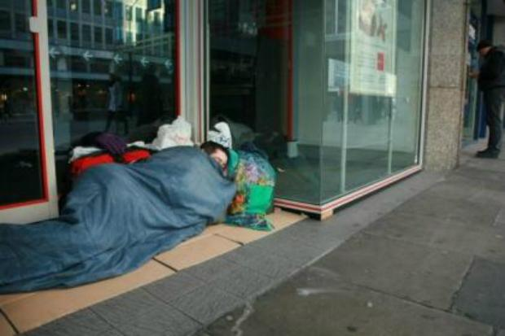
Failing housing system.
Rough sleeping increased 18% since 2016, and 170% since 2010.
4,751 were found sleeping out Autumn 2017 (DCLG)
Households accepted as homeless up 43% and in temporary accommodation up 60% since 2011 (House of Commons Library)
Notes:
Rough sleepers doubled in London during this period
Homeless acceptances 48% rise since 2009/2010 - vulnerabilities, children sickness disabilities, and in ever more stringent circumstances (gate keeping) and homeless prevention
Numbers in TA 78,180 households in temporary accommodation at the end of June 2017. Rising steadily over the last 6/7 years -Of these households, 54,180 (69%) were placed in temporary accommodation in London
But also hidden homeless people sofa surfing, staying with friends, people in hostels etc.
Increase in rough sleeping visible tip of the iceberg.
This is more acute in London and south east but also other high pressure housing markets of the north and midlands but less so in low value areas of north.
Overwhelmingly due to end of private sector tenancy- welfare reform, selling up cashing in

Slide 4
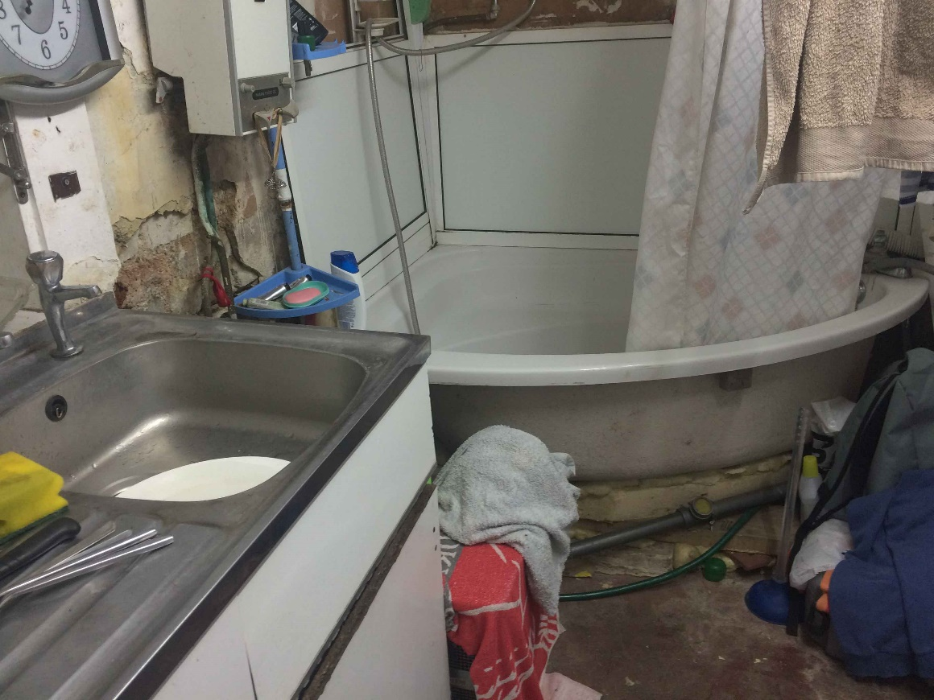
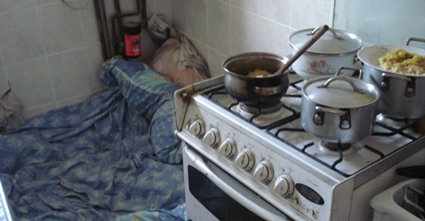
Private rented sector does not meet needs of all
27% of privately rented homes were ‘non-decent’, 38% of private lets include children (EHS, 2016/17).
Rents in England increased 16% 2011-2017 (ONS, 2017), real earnings increased 4% (ONS, 2017)
Notes:
PRS insecurity cause of homelessness in pressured markets
PRS also expensive, pushes more people into poverty once housing costs are taken into account in many locations.
But also PRS site of poor housing conditions 27% non –decent- even new homes in PRS poorer condition than social housing, as management is not professional.
But private renting remains the worst performer by far only (!) 13% in social housing and 20% owner occupiers.
Between 2006-07 and 2016-17, the number of households with dependent children in the private rented sector increased by about 966,000 as fewer families can buy or even enter social housing. More families in PRS than in SRS now.
The sector is highly variable with high end rented luxury apartments and houses too but These are extreme benefit dependent end of PRS where so called slum or rogue landlords cram people in- these are from Newham in East London where they have put a lot of resources into prosecuting and regulating local landlords. Less acute but return of squalor evident in every LA I wager. Certainly in York.
These feed into calls for reform in the sector, greater regulation, better management, secure tenancies and better conditions. Not least as fewer but more acute vulnerabilities in the PRS my colleagues suggest.
A lot of institutional investment in new build Build to Rent sector (pension funds) but expensive and niche offer- professional market,.

Slide 5
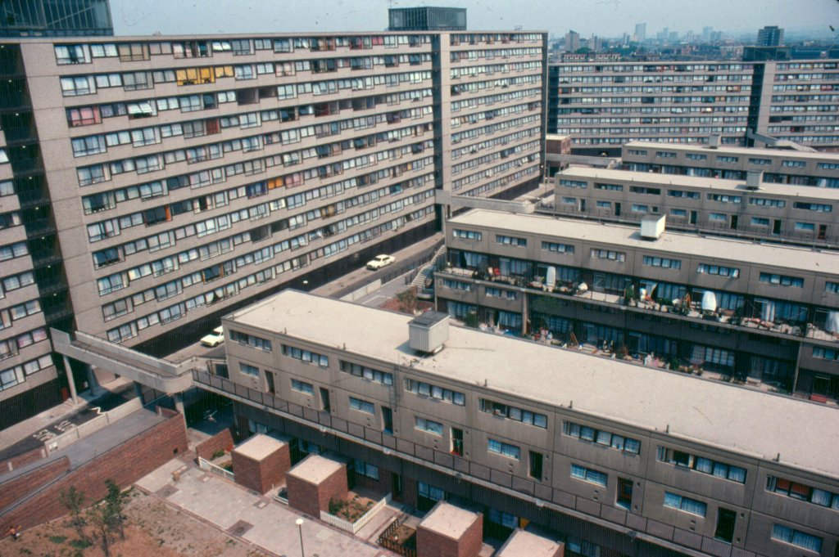
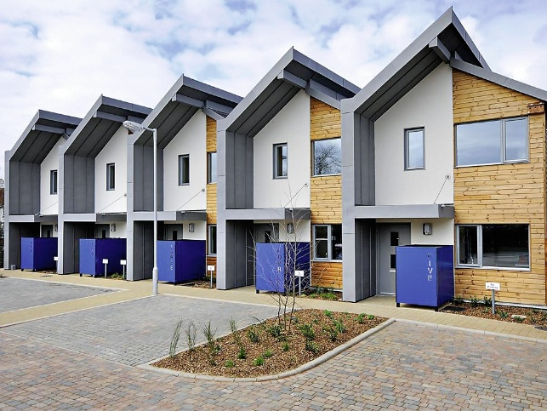
Limited access to social housing
1.2 million on local authority waiting lists
379,000 lettings during 2014/15 and falling – only 231,000 in 2016/17 (40% fall 2 years)
12,826 Right to Buy sales 2016/17 but only 41,530 ‘affordable’ starts (England) (DCLG)
Notes:
Grenfell showed contracting and construction industry, management issues, stigma, lack of tenant participation and marginalisation
So industry and social housing sector a lot to learn and not be complacent
But remains it is a tenure that many lower income households aspire to- better physical conditions than PRS and HO although environment has attracted less investment- but its in demand but getting increasing harder to access and limited new supply.
But The 41,530 affordable homes delivered in 2016/17 comprised 5,380 social rent, bastadrised the word saffordable 24,350 affordable rent and 11,810 intermediate affordable housing. DCLG data.
Regeneration of estates as land values increase and can be sweated in London particular flashpoint between tenants housing activists and local authorities and developers on the other. This is the Ayelsbury estate in Southwark, passed to international developer for low value and now very few social homes on site and many private flats for sale and many gone to overseas speculative investors. But also played out in Manchester and other cities where impulses have been repeated.
One of the main things now as that policy was drifting towards Social housing becoming emergency ambulance service rather than mainstream tenure of choice as it once was 30% in 1979. Also subject to the right to buy so homes are lost out the back door and not always replaced at the same rate.
Trial of RTB in HAs in West Midlands.
Even leading trade bodies for social housing landlords weren;t calling for more social rented homes until recently as opolitics in government was n;t favourable. Mood music on social housing changed and now I feel more optimistic that the social housing green paper will no longer signal the death knell of the tenure that their last one did.

Slide 6
Homeownership unaffordable?
35% of first time buyers had help from friends and family (up 21% 1994-5) and 10% used inherited money (up from 3% 1994-5)
72% first time buyers in 4th and 5th income quintiles (2015/16)
72% new buyers were couples (up 63% 1994-5) (DCLG 2016/17)
Notes:
Portrayed as an age intergenerational inequality and true fewer younger people under 30 are homeowners than in previous years.
Ten years to 2016/167 25-34 year olds in owner occupation decreased from 57% to 37%
But who is being squeezed out? Average first time buyer not an average incomes, but higher.
Each new cohort of homeowners more and more professional occupations and less and less routine occupations and self employed (JRF report)
So also a class issue.
Over half (52%) mortgages 30 years or more, used to be 25 years in debt longer , most of these 35 or more.
Only way to make repayments affordable but goes into precarious years bordering retirement/ill health.
Harder for single people to afford ownership now, although slightly easier in recent years. 80% of FTBs were couples a year ago.

Slide 7
Housing as a store of wealth
Estimated £37bn flowed into London’s property market from overseas between 2006- 2013 (Atkinson)
£170bn of UK real estate held by more than 30,000 tax haven companies (Atkinson)
More prosaically, housing equity tied to pension planning, impact on incentives to downsize, buy to let and wealth inequalities.
Notes:
Key feature of housing is that rather than satisfy housing needs and desires in terms of shelter, status but since 80s increasingly about its investment qualities, its asset rather than use value.
And not just by domestic buyers but properties in London especially but also other cities Manchester Sheffield international buyers using new build homes especially as a safety deposit boxes, somewhere to store their wealth, a safe haven for money away from tax authorities or policy money laundering , or somewhere to provide a better return on investment available in China Hong Kong etc.
Moreover domestically housing wealth tied up in pension planning, is used to tide people over short term income dips by borrowing more on the mortgage (cost little) and slightly dampened recently but provokes investment in second homes and buy to let as a rental income and capital money spinner as house prices rise.
Rational response to poorly performing pensions and reduction in pension benefits in recent years. But big impact on housing market.
Rather than be a nation of homeowners as once suggested – UK moderate in HO% across globe- confined to a smaller portion of households and more households own more than one home.

Slide 8
Are we building enough homes?
Estimated c.240,000 homes required annually, averaged 168,000 since 2001
Changing demography – divorce, ageing, migration, solo living produce more households
Absence of public investment in housing since 1980s
Increasing over-reliance on speculative house builders
Housebuilding risky, uncertain and expensive long term endeavour
Land ownership and planning limit small and community builders
Cyclical outputs damage supply chains and contribute to skill shortages
Building for rent counter-cyclical – private and social rent – and speeds outputs
Shift from bricks and mortar subsidies to personal subsidies (£ spent on housing benefit rather than new homes)
Notes:
What happened? So why has housing become such a pressing issue?
So lets look at new supply. Many people argue this is main reason that has fueled the housing crisis, cross spectrum.
Historic under-supply of new homes, or at least since the 1970s. We have needed 240 -300,000 homes but achieved 150,000 or so each year since then so huge backlog of homes needed. Last years hitting 200,00 but needs sustained and not always what is needed.
Also demographic changes – people living in their homes longer as people are living longer.
We divorce separate or choose to live alone for longer ev3en if have a partner so even with rising the number of households has grown over time,
But drop in new household young people setting up independent home since 1990s (40% drop in London!)
But governments have over the last 30/40 years increasingly underinvested in affordable social rented public housing and from the 1980s relied increasingly on market mechanisms private finance and from 90s onwards and 2000s on builders to allocate a proportion of the private sites they build as social affordable housing.
There is also a reliance on large house builders to supply new homes whereas they will only build at the speed that they can sell at best prices
That is their business model, not necessarily bad, but logic of how they satisfy their shareholders.
Biggest falls in new supply are because the public investment withd4rew from the market.
So moves now in community led housing, for councils to take control of land and build out at the rate communities need
And also much interest in new models of housing, community led schemes
Advantages of this is that they can build consistently not only when prices are high and they won’t grind to a halt when the market falls.
Public housing investment used to be put in bricks and mortar now all goes into housing benefit which creastes no assets or surpluses over the long term and is just lost
Bricks and mortar subsidies fell 28% to 17% vs personal housing allowances up from 58% to 71% (2008/9 -2012/13) (Tunstall)

Slide 9
‘financialisation’ of housing
“… structural changes in housing and financial markets and global investment whereby housing is treated as a commodity, a means of accumulating wealth and often as security for financial instruments that are traded and sold on global markets.”
(UN Rapporteur on Housing Leilani Farha 2016)
Notes:
Lack of new housing supply but the increasing ‘financialisation’ of homes fuelled by the onset of cheap credit
People could buy more house for same monthly outlay so prices bid up and up
And demand increases with speculative purchases capitalise on that rising prices
Coupled with an almost lack of building homes that people at the bottom income spectrum can access and afford.
Property assets central to wealth inequalities and asset based welfare - indiviudalised support rather than collective
Permissive tax and policy support for homeownership and property assets – homeownership preferable in todays system as policy has made it so
Mortgage market innovation engaged domestic homes into global circuits of capital – up to crisis endless innovation to engage more people in financial services
New financial instruments supported amateur and professional property investment

Slide 10
Housing policy matters
Housing has long been a “wobbly pillar” of the welfare state as frequently privately provided
UK has a deeply dysfunctional housing system in the UK
20th century one of state intervention in failing market
But 30 years (or more) shift towards recommodification and marketisation of all sectors of housing system
Driving inequality as greater wealth accumulates for some while others homelessness or unsatisfactorily housed.
Policy levers on public and private players include land acquisition and control, direct provision, subsidies, underwriting debt, equity stakes, taxation
Need long-term cross party commitment to overcome entrenched problems
Notes:
So what do we do about all this mess of a housing system?
Long been a weak part of overall welfare and social policy as for the most part built and experienced privately
But the state’s retreat from housing provision combined with housing seen as a speculative asset and limited new supply has meant those with fewer resources squeezed out of housing or into sub-standard or unaffordable or insecure accommodation.
And contributed to wealth inequalities we’ve witnessed.
To fix the market an array of policies need implemented to weaken the speculative impulses in the market – additional tax on private landlords, but could also consider taxes on capital gains as in other countries, inheritance tax, incentives to limit the accumulation of more housing than we need. Powers to control land and invest in public housing which is cheaper in the long run
Politicians short term , do things in parliaments terms but need long term resolve to turn the market around-
growing cross party interest in thigs that were unspeakable just a few years ago, like land taxation, public delivery of housing Homes England.
Hard to feel hopeful in the world right now but have more of it than a few years back.
Growing interest in Community led housing is small scale but important contribution to this. CLT meets the objectives of sheltering housing from the open market to preserve element of affordability in perpetuity and meet needs. Reasserts the use value of housing rather than the asset value what has been the most prominent thing in recent times.

