Slide 1
Community Led Housing
Yours for now
Yours for the future
Jo Lavis, Vice-Chair
National CLT Network & East Midlands Community Led Housing
Notes:
Jo Lavis
Specialism is delivery of rural affordable housing
Recognised that more than way of providing, but central to all of them is that it meets the needs of that community now and in the future.
Yes, can be a housing association – but it could also be the community themselves
Nigel has showed us the opportunity
Angela –CLH in the form of the co-housing model
I am going to give a quick canter through the CLT approach and how NCLTN can support you.
Setting the context for Tom’s talk on the fantastic schemes in the SE

Slide 2
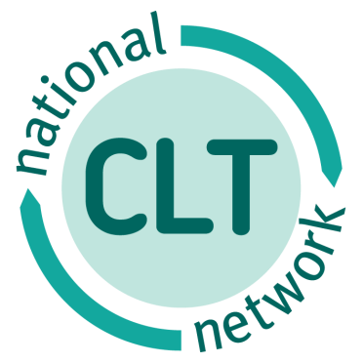
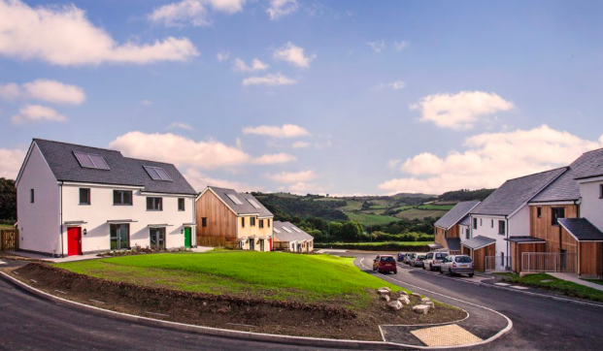
Why we do it
“Once the crashing need had been identified the village almost unanimously agreed that ‘our own’ shouldn’t be left to fend for themselves.
“The health of the school, the need for a dynamic and young workforce in the area and simple human decency to allow people to live in the area in which they had been raised – that was what was important to us.”
Christow CLT
Notes:
This is Christow – a village on the edge of DNPA
18 new passiv haus homes – 14 of which at genuinely affordable rents for local people.
Developed by Christow CLT in partnership with Hastoe HA and Teign Housing with support from Wessex CLT
Relentless campaigning by a local resident led to 8 people coming together to form a CLT - co-incidently and helpfully with different skills
“and a Chair that keeps you on track when you go off at a tangent’
Key goal to keep the community informed and onside
Some of the original directors have moved on but new ones have joined.
As well as the homes used income to support community energy project, village hall rennovations and new sports equipment for the school.

Slide 3
Plus a lot of this……..
Notes:
Communities are integrally involved, in control, they own the process and eventually the land and homes. They aren’t just people getting more involved in a consultation.
CLTs are a form of CLH – alone or in combination with other models e.g Bridport
Pinchbeck – the first Lincolnshire scheme- fed up of waiting took control – Championed by the PC Chair – Maurice centre stage – PC land – Tenaicty and drive of the CLT Chair – ex policeman
Youlgreave – PDNPA – affordability a major problem - really active – came out of NP
St Teath – Cornwall – scheme of 12 homes – 8 available as discounted market sale for people with a local connection. Sold at 60% of omv with the same % discount on market prices when it is re-sold, in perpetuity. Helped by LP policy for setting benchmark values for affordable sale.
Lyvennet – Cumbria Developed 12 affordable homes, and 8 plots for self-build on a former stoneworks site in rural Cumbria. community plan showed housing as a top priority, no one was building but the character of the village was going to be lost, so built it themselves. Raised money by abseiling down the church spire!
Half-way through the build process, the pub closed. So they bought that too as a community-owned business, coming up to its second birthday this summer. Collective refurb project: 4000 hours of volunteer input, some people never missed a day.

Slide 4
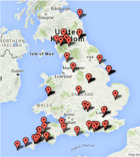
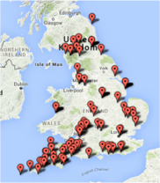
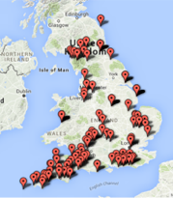
‘We will do it ourselves’
2010
2013
2016
Notes:
Grown six times in six years – now 225. 700 homes built and another 3000 in pipeline by 2020.

Slide 5
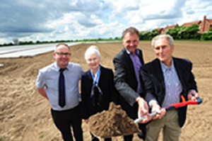
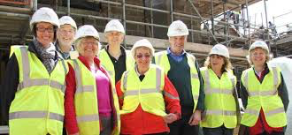
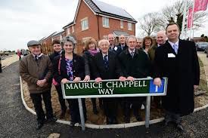
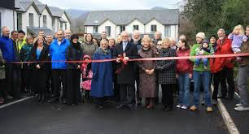
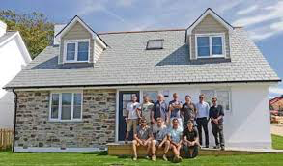
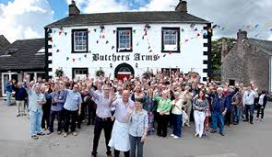
What is Community Led Housing?
Community engaged and in control throughout the process
Community ownership/stewardship
Builds homes local people can afford
In perpetuity
Important customers to SME builders
Make good places
Notes:
Communities are integrally involved, in control, they own the process and eventually the land and homes. They aren’t just people getting more involved in a consultation.
CLTs are a form of CLH – alone or in combination with other models e.g Bridport
Pinchbeck – the first Lincolnshire scheme- fed up of waiting took control – Championed by the PC Chair – Maurice centre stage – PC land – Tenaicty and drive of the CLT Chair – ex policeman
Youlgreave – PDNPA – affordability a major problem - really active – came out of NP
St Teath – Cornwall – scheme of 12 homes – 8 available as discounted market sale for people with a local connection. Sold at 60% of omv with the same % discount on market prices when it is re-sold, in perpetuity. Helped by LP policy for setting benchmark values for affordable sale.
Lyvennet – Cumbria Developed 12 affordable homes, and 8 plots for self-build on a former stoneworks site in rural Cumbria. community plan showed housing as a top priority, no one was building but the character of the village was going to be lost, so built it themselves. Raised money by abseiling down the church spire!
Half-way through the build process, the pub closed. So they bought that too as a community-owned business, coming up to its second birthday this summer. Collective refurb project: 4000 hours of volunteer input, some people never missed a day.

Slide 6
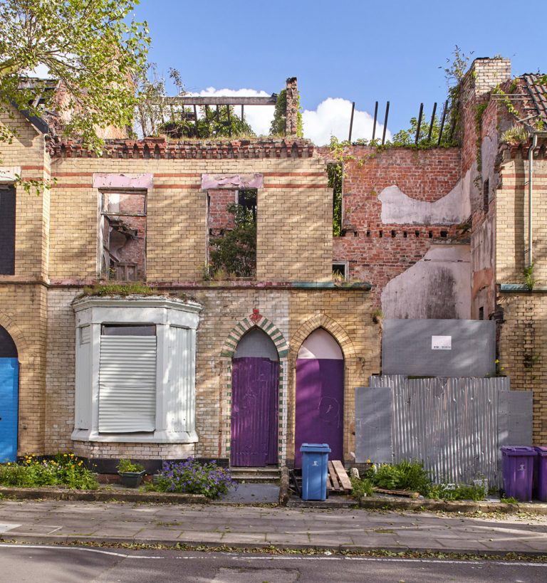
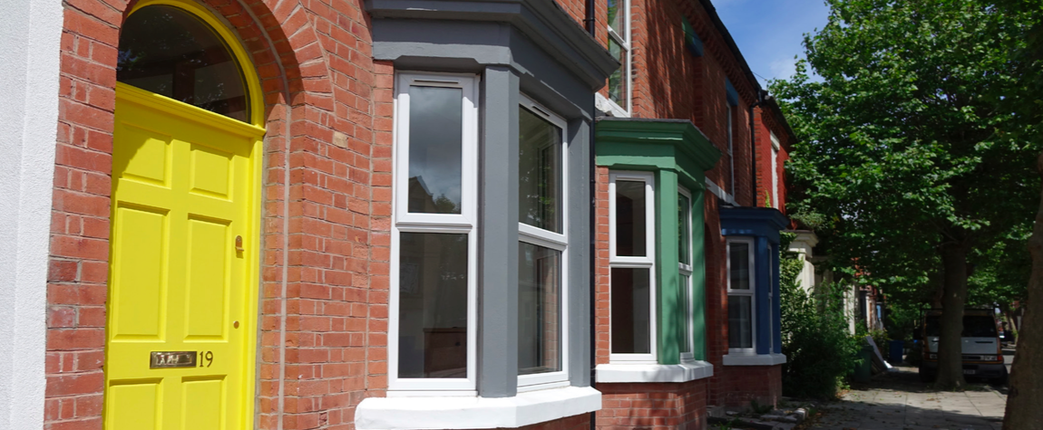
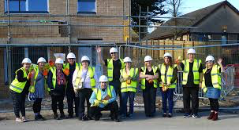
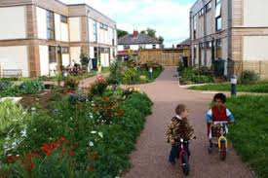
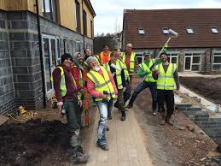
Community Led Housing
NOT one size fits all
Shared principles
Common legal forms
Community Land Trusts
Co-operative housing
Cohousing
Custom Build
Notes:
Communities are integrally involved, in control, they own the process and eventually the land and homes. They aren’t just people getting more involved in a consultation.
CLTs are a form of CLH – alone or in combination with other models e.g Bridport
Pinchbeck – the first Lincolnshire scheme- fed up of waiting took control – Championed by the PC Chair – Maurice centre stage – PC land – Tenaicty and drive of the CLT Chair – ex policeman
Youlgreave – PDNPA – affordability a major problem - really active – came out of NP
St Teath – Cornwall – scheme of 12 homes – 8 available as discounted market sale for people with a local connection. Sold at 60% of omv with the same % discount on market prices when it is re-sold, in perpetuity. Helped by LP policy for setting benchmark values for affordable sale.
Lyvennet – Cumbria Developed 12 affordable homes, and 8 plots for self-build on a former stoneworks site in rural Cumbria. community plan showed housing as a top priority, no one was building but the character of the village was going to be lost, so built it themselves. Raised money by abseiling down the church spire!
Half-way through the build process, the pub closed. So they bought that too as a community-owned business, coming up to its second birthday this summer. Collective refurb project: 4000 hours of volunteer input, some people never missed a day.

Slide 7
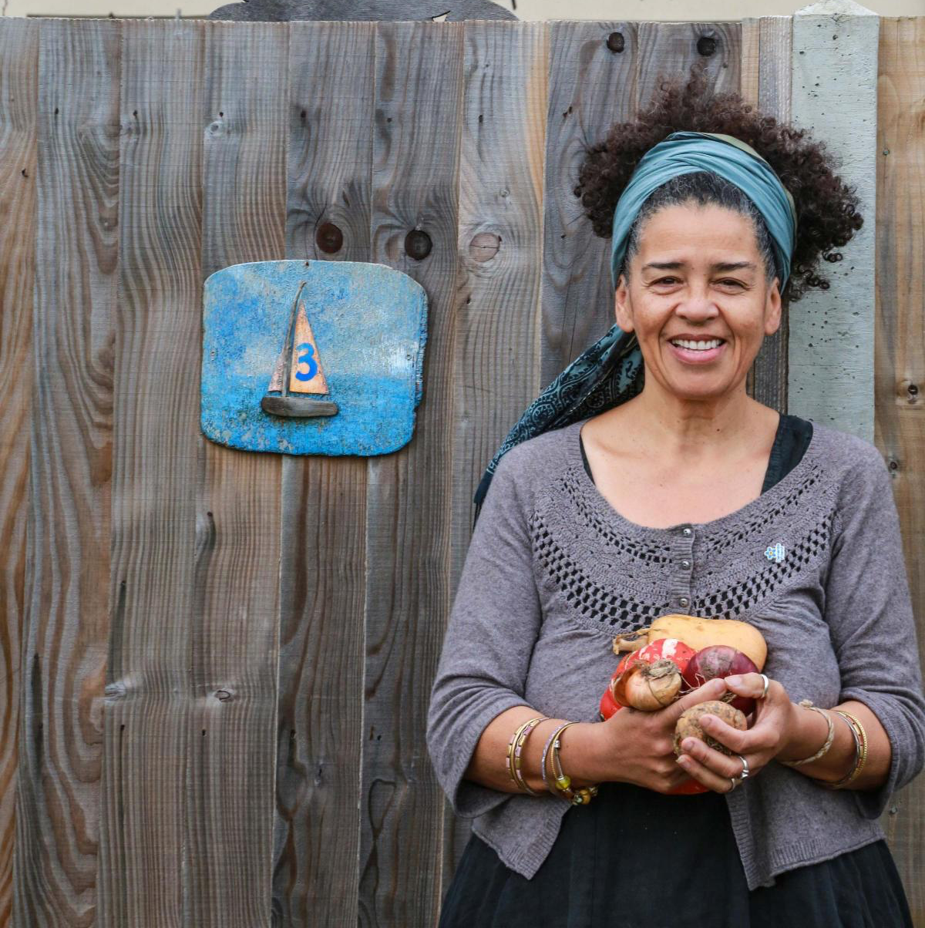
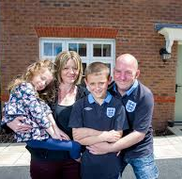
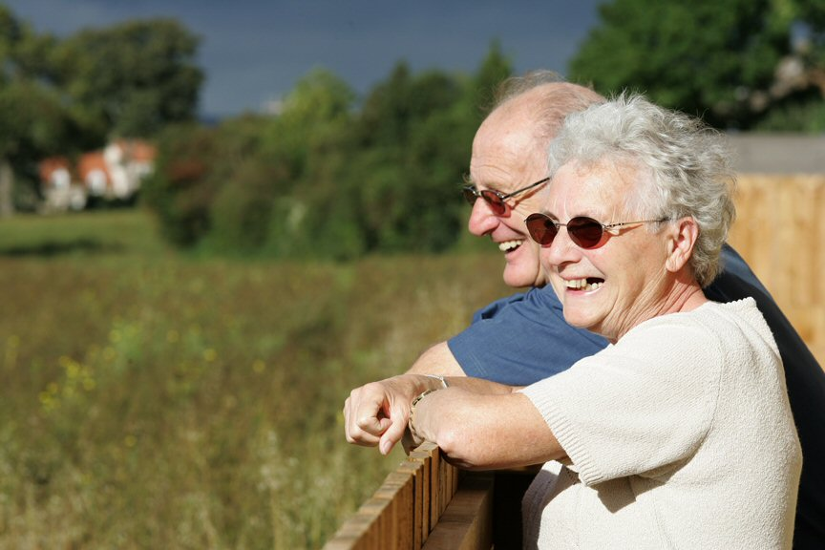
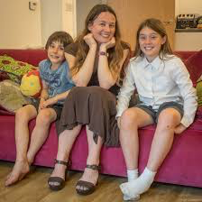
Flexible to meet different types of housing need
Affordable Rent
Living Rent
Social Rent
Shared Ownership
Market housing
(subsidy for affordable homes)
Discounted Market Sale
Resale price covenant
Notes:
CLTs provide homes for people from different walks of life, different age groups, providing range of affordable housing
AR – up to 80%
SR – because AR not affordable – now HE grant available
Living Rent – linked to local incomes
SO – part rent/part buy
Discounted sales – resale price covenant e.g. Cornwall – LY - % price tie / East London income tie to resale
Market housing – can provide subsidy for affordable homes – or be sold as long as sales income re-invested for benefit of the community
Usually a mix of these within a scheme

Slide 8
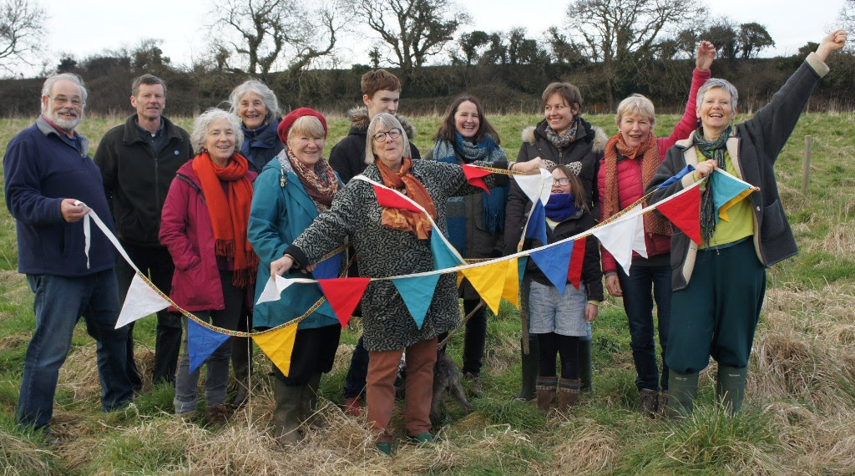
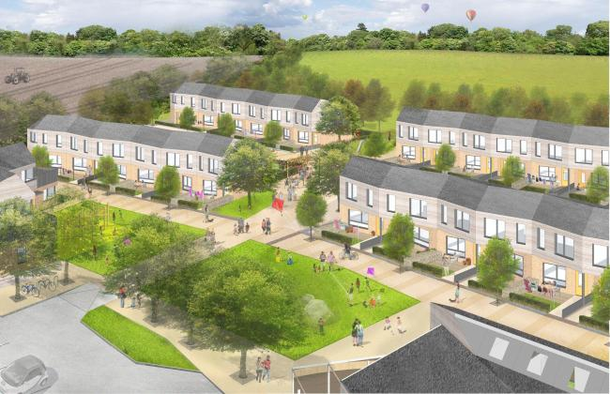
It can be a bit of a mix
Bridport Cohousing CLT
Incorporated as a co-op
Homes
Mix of:
Rent from HA
Leasehold 80% omv
Shared house
Allotments

Slide 9
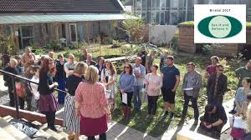
National Community Land Trust Network
here to help you
Support for new groups
CLT Start Up Fund
See it Believe it
Free online resources
Model Rules for Community Benefit Societies
Interactive map – where – who - how
Support for members
Example policies and procedures
Discounts on model rules
Legal advice line
Developing the sector
Campaigning/Lobbying
Mortgage brokering/Crowdfunding
Notes:
NCLTN – Registered Charity
recognises the importance of face-to face support so funds for communities to buy this in from accreditied Technical Advisers e.g. Tom
No point re-inventing the wheel – so some model forms and documents
Some issues need national action, government – RTB - CHF ability to operate at scale – mortgage lending/bokering

Slide 10
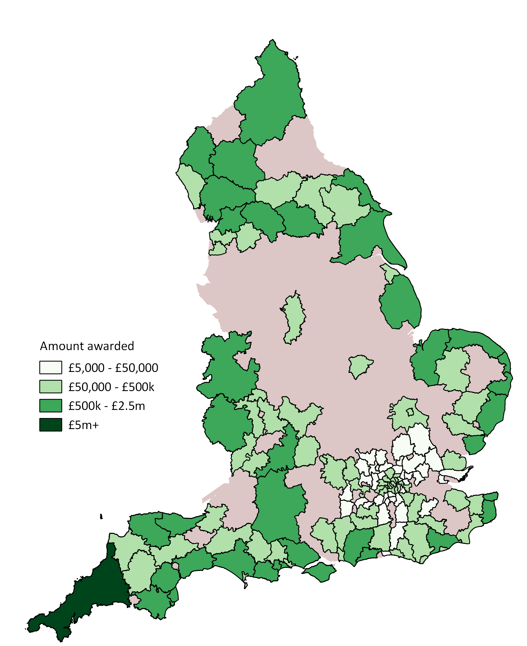
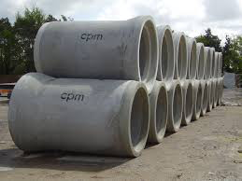
Community Housing Fund
Hot off the press!
£60m per annum for 4 years
CCH & UK Cohousing & NCLTN
Phase One
Infrastructure
Expanded HUB network
Technical adviser training & accreditation
CLH website
Phase Two
Capital grant
&
Revenue -
Professional Technical help
Notes:
NCLTN – Registered Charity
recognises the importance of face-to face support so funds for communities to buy this in from accreditied Technical Advisers e.g. Andy Lloyd who assisted Bill
No point re-inventing the wheel – so some model forms and documents
Some issues need national action, government – RTB - CHF ability to operate at scale – mortgage lending/brokering

